Slide 1
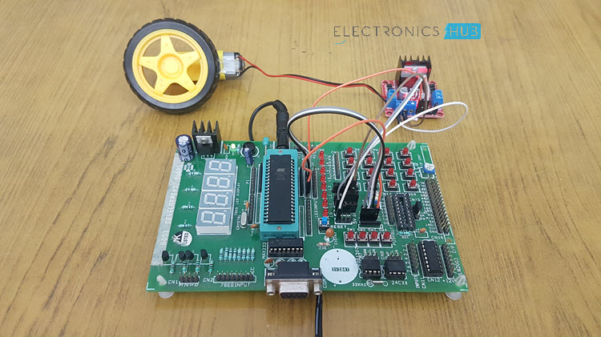
DC motor interfacing using 8051 microcontroller
BY:
1602-19-733-118 → Ramakanth.SVN
1602-19-733-101 → Sathwik.Y

Slide 2
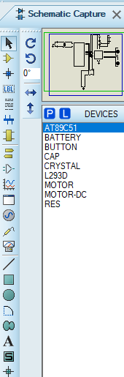
COMPONENTS USED:
AT89C51 Microcontroller - 8051 microcontroller
DC motors
L293D Motor Driver
Resistors
Switches

Slide 3
NEED FOR USING DRIVER IC:
It is not good to connect DC motor directly to the microcontroller. Since the maximum current that can be sink from 8051 microcontroller is 15 mA at 5v. But a DC Motor needs much more currents. It also needs more voltages as 6v, 12v, 24v etc. depending upon the type of motor used. Another issue is that the back EMF produced by the motor may affect the proper functioning of the microcontroller and reversing the direction can damage the controller. Due to these reasons we can’t connect a DC Motor directly to a microcontroller. To overcome the problems in their interfacing, a motor Driver IC is connected between microcontroller and DC motor. Motor driver is a little current amplifier. It takes a low current signal and gives out a high current signal which can drive a motor. It can also control the direction of motor. We can use any Driver IC like L293D.

Slide 4
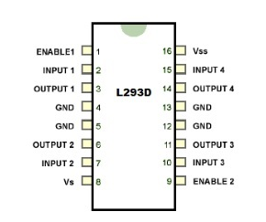
L293D PIN DIAGRAM
.

Slide 5
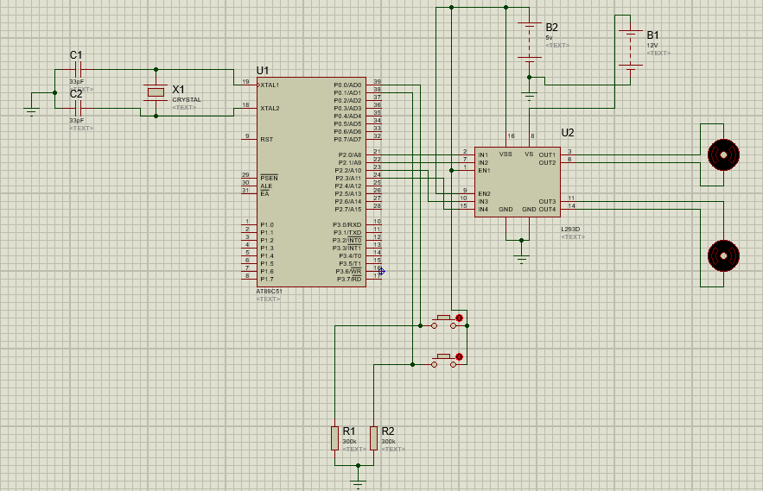
PROTEUS SIMULATIONS - Circuit:
.

Slide 6
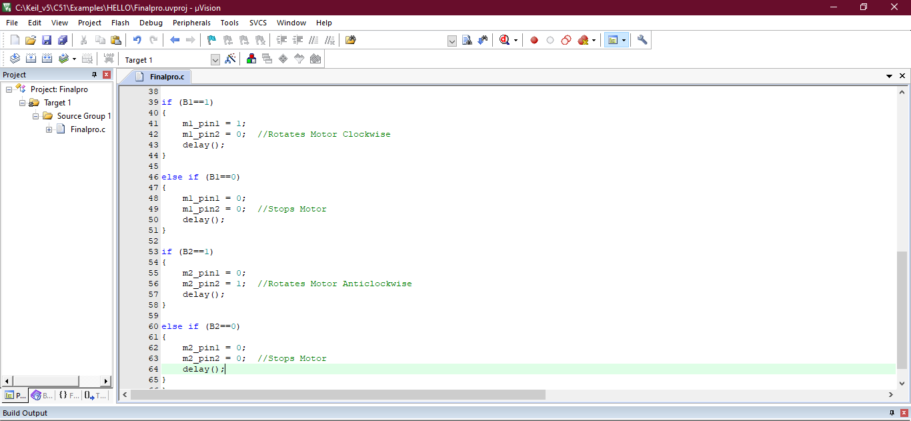
HEX FILE:

Slide 7
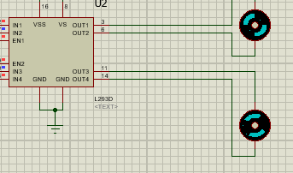
Working:
The driver IC L293D is connected between 8051 Micro controller and DC motors. When the 2 buttons are enabled, one motor is interfaced in clockwise direction and other in anti - clockwise direction.
Clock-wise Rotation
Anti-Clockwise Rotation

Slide 8
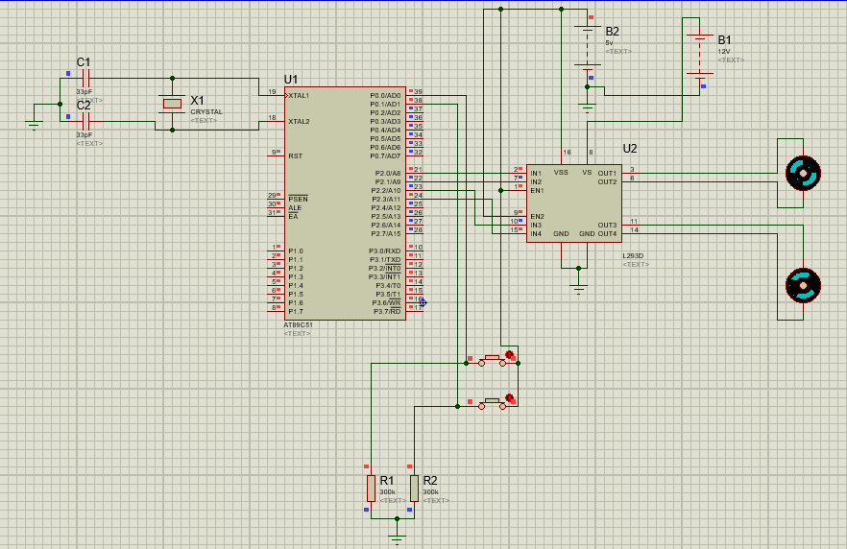
Output:
.

Slide 9
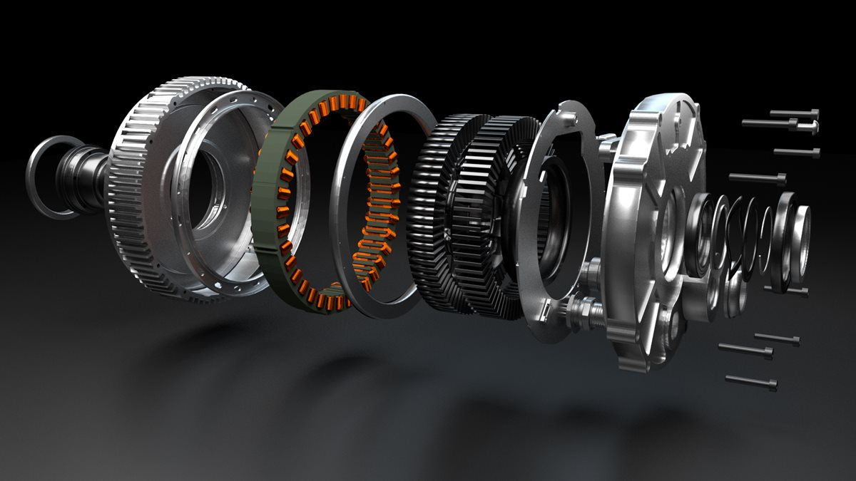
APPLICATIONS:
This concept is used in robots to control the robot directions.
Used to control the speed of the DC motor.
It is used in the applications where we need to drive the high voltage motors

Slide 10
CONCLUSION:
Hence this project Demonstrates DC motor interfacing using AT89C51 Microcontroller and L293D driver IC. This has huge range of applications in Robotics.
- THANKYOU

